Slide 1

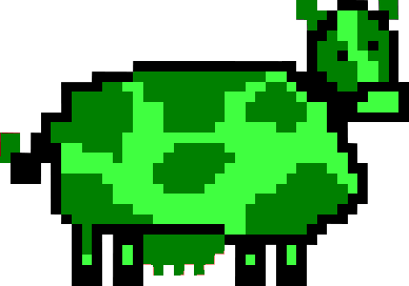
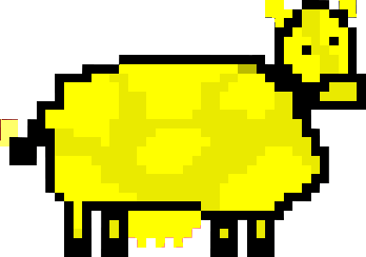
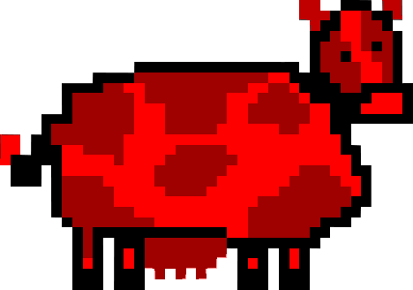
Cow Panic! – Group 6301
Key achievements in the last week
Completed the initials-cycling feature for inputting a player name Averted the cowpocalypse when the game broke (fixed the game-breaking glitches that popped up during the Week 7 lab period) Finished Cow Panic! logo Investigated implementation of cow variations Implemented score-saving Created colored cows for the status report Added Cow Panic! logo to status report
Plan to keep/get project to Green status
Keep up with the Gantt Chart schedule Research how to implement features such as score saving and HUD outside of class Plan to meet outside of class time to continue developing the game
Key planned activities for the next week
Continue creating art for the game and working on the game’s moosic Add font to initials-input Test lives-tracking and score-saving Add lives and score displays in-game Add the main menu Add cow variations Create an options screen Start system manual and user manual
Key risks / issues / scope changes
Possibility that HUD will be difficult to implement Saving scores to a file may cause bugs and must be completed after the lives tracking has been implemented Possibility that SourceTree will rise from the grave and casting darkness over the land (again), exhuming many bugs that had long ago been buried
5/18/16
Legend: Yippee!!! Meh… DEFCON 1!!!

Slide 2
Project Name and Team Number
Key achievements in the last week
[Detail the key achievements in the last period]
Plan to keep/get project to Green status
[Detail the key achievements in the last period]
Key planned activities for the next week
[Detail the key planned activities for the next period]
Key risks / issues / scope changes
[Detail key risks and issues]
Date
Legend: Yippee!!! Meh… DEFCON 1!!!

